Slide 1
Micro Credit Defaulter Project
By
Dumpala Aditya

Slide 2
Data preparation With the help of pandas library we can import the data set from local drive Observations form the data set which is imported(overview) Data set shape is (209593,37) ➔no null values Some of the features are not having proper data type like it looks numbers but it shows object dtype Difference between mean and standard deviation is not reasonable due to variance is high And min values in the data set is not makes sence in some features And some other features has min , median, 75% are showing zeros it means there are more no of zeros are present in that features and also there are 6 features are having more than 90% of the data is zeros Outliers are present in each feature due to min values and max values are maintaining too much difference Skewness is not in acceptable range for in every feature Some features are having high correlation between them

Slide 3
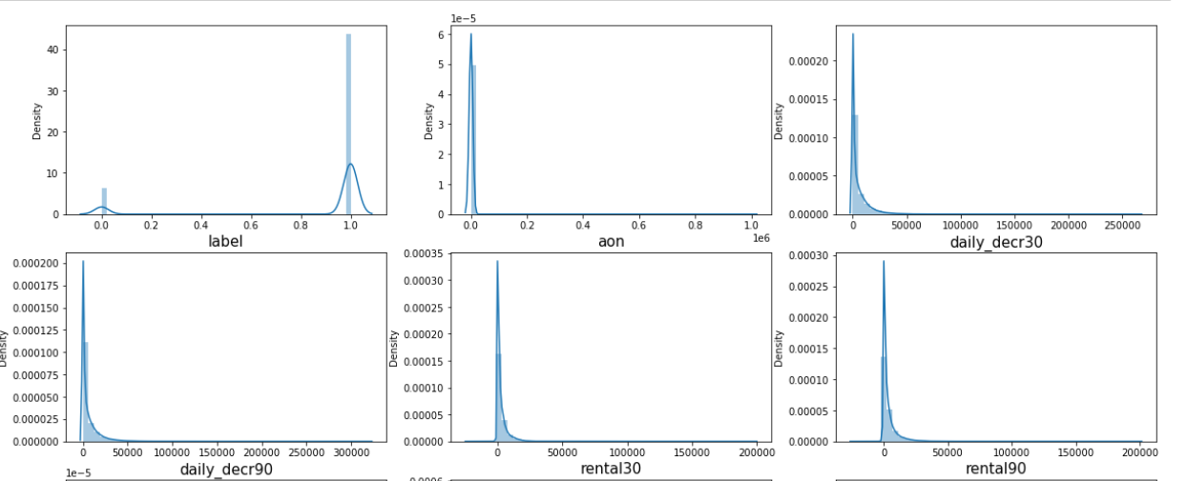
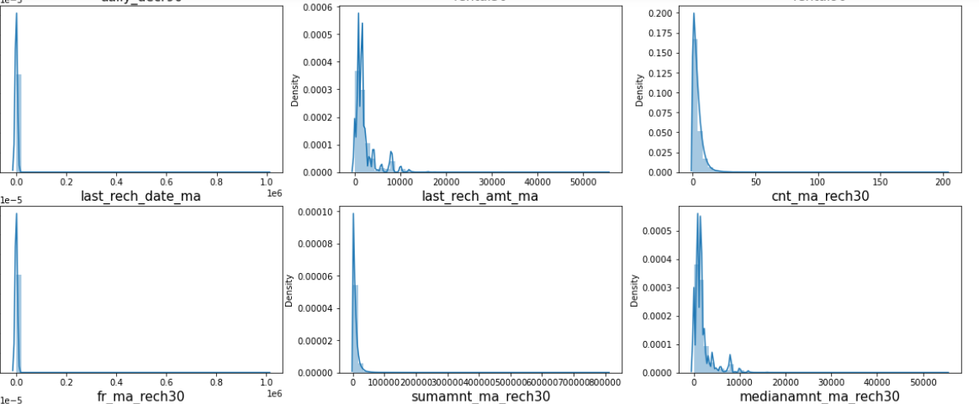
Data cleaning We don’t worry about null values because they are not present in our data set some features like 'Unnamed: 0','msisdn' are not usefull so we drop them Extracting day and month from pdate feature and drop the pdate after extracting the day and month after checking data.describe there are some features having more on of zeros so we can drop those features from the data Checking skewness

Slide 4
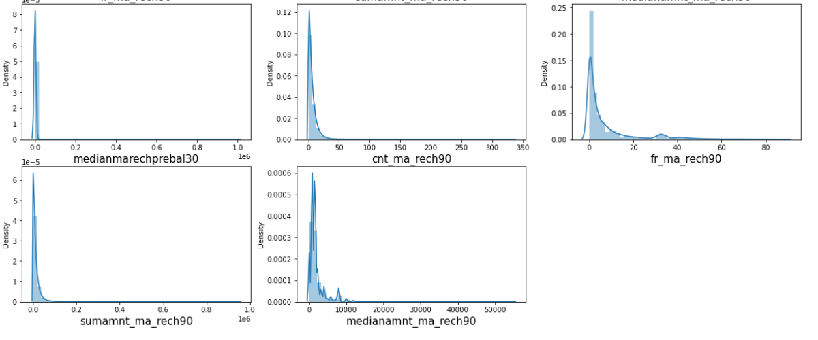
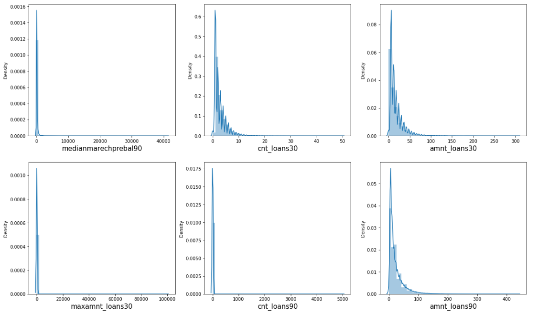
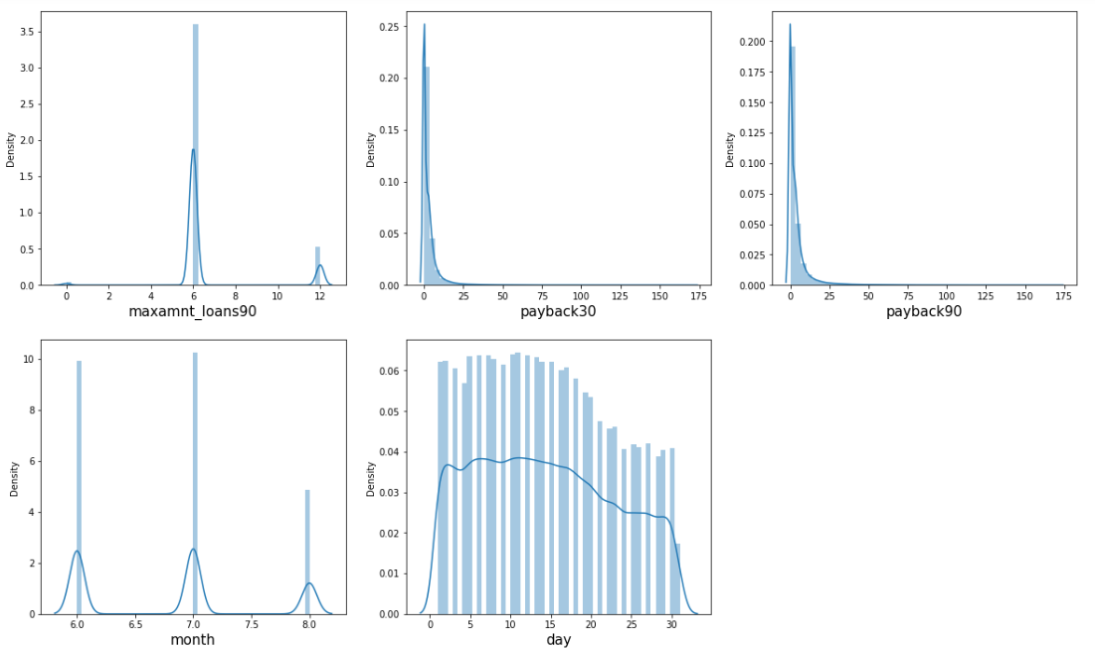
Observation:- We can see that except label, maxamnt_loan90, month and day remaining all are skewed right side highly I can use power trsnformation for removing the skewness

Slide 5
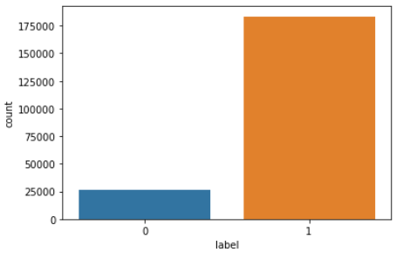
Label
Observation:- Our target variable is lokks imbalanced Iam using SMOTE technique for balancing the categories

Slide 6
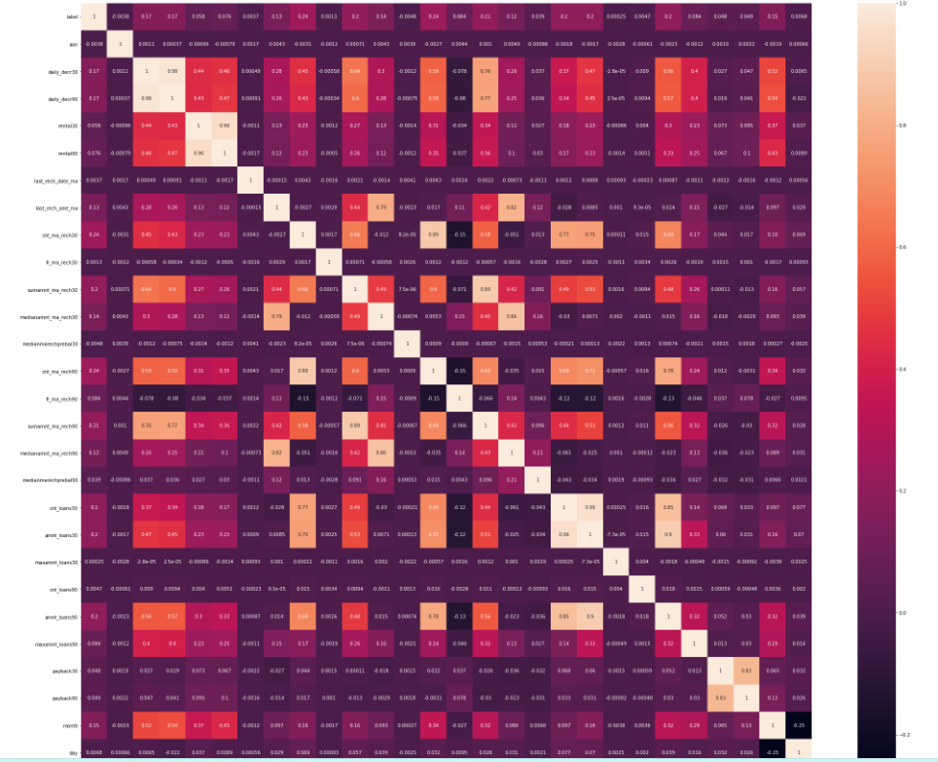
Correlation by using heat map
Observation:- There are some features are highly correlated they are 'daily_decr30','rental30','amnt_loans30’ and 'daily_decr90','rental90',’cnt_loans90’ 'daily_decr30','rental30','amnt_loans30’ are less correlation with the label so I drop these features from the data set

Slide 7
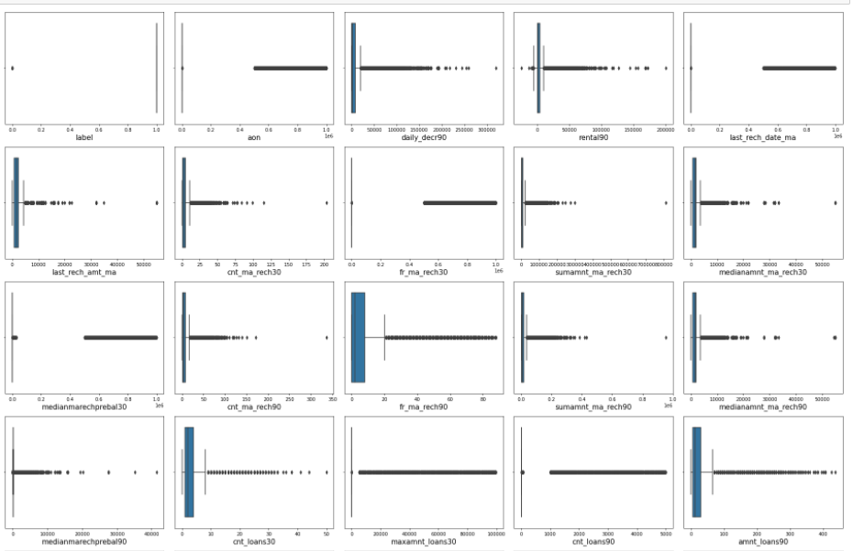
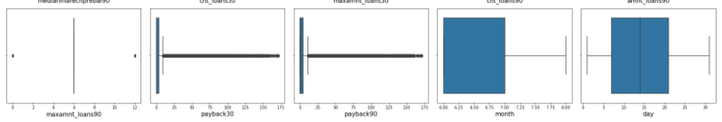
Outliers
Observation:- There more no of outliers are present in each features except month and day Iam using zscore for treating these outliers and threshold point iam using is 4.5 since I don’t want to loss any important data

Slide 8
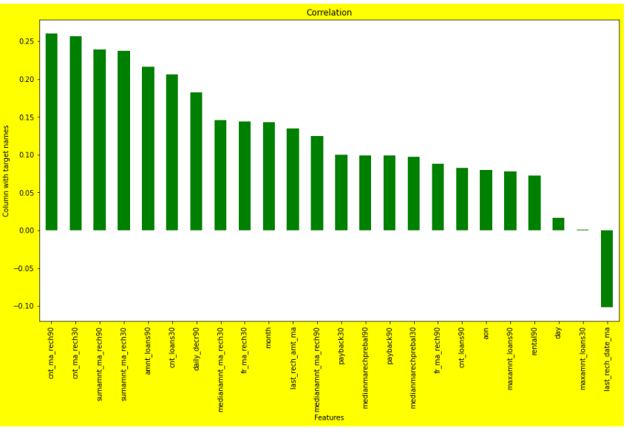
Negative values in features ➔ negative values in some features are not makes any sense so I remove those negative data from those particular feature Zero as minimum value in some features ➔ yes it is possible to have zwero as minimum value in some features so I cannot change those feature data correlation with the target variable Observation:- ➔there are almost all the features are good correlation with the label we can see in the above plot ➔ There is another two features having the less correlation with the label they are day and maxamnt_loans30

Slide 9
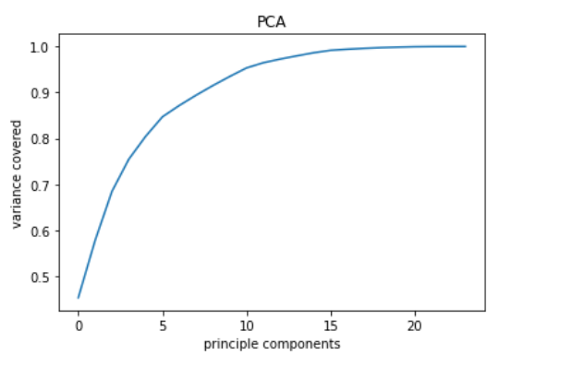
Scaling the data ➔ iam using min max scaler for scaling the data and it scales the data max is 1 and min is 0 ➔ we scale the data for better understanding for the model PCA(PRINCIPLE COMPAONENT ANALYSIS) Observation:- ➔ We can see that there are more than 15 components are covering morethan 95% of the data so iam choosing 18 components

Slide 10
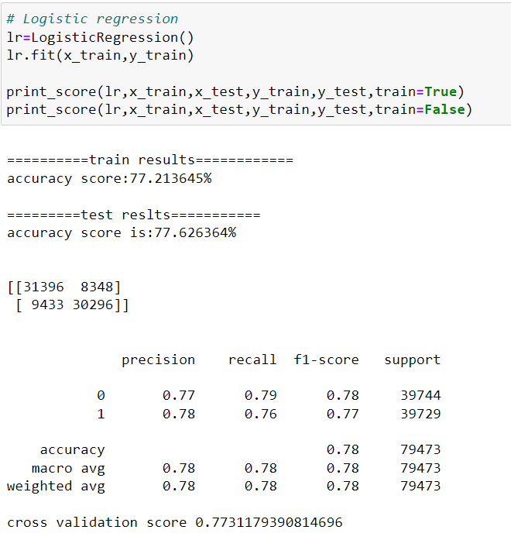
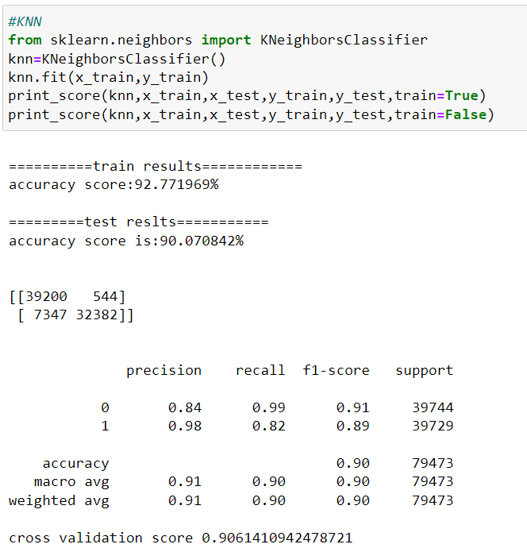
Model building and there results logistic regression KNN

Slide 11
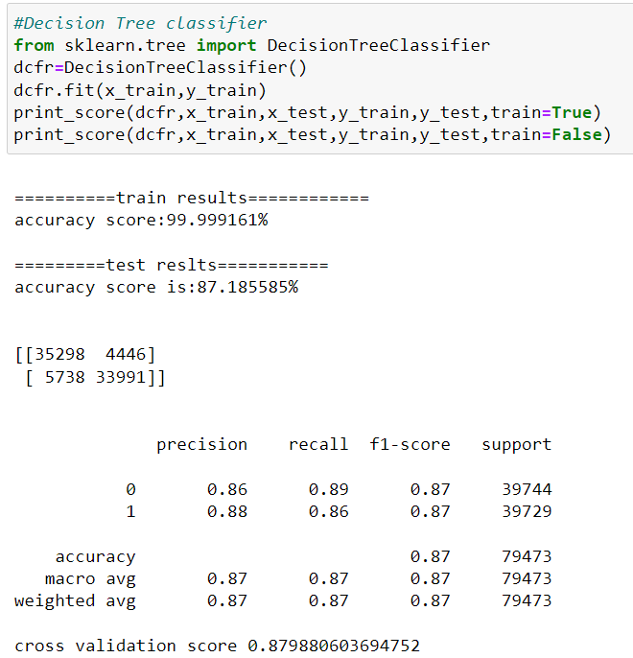
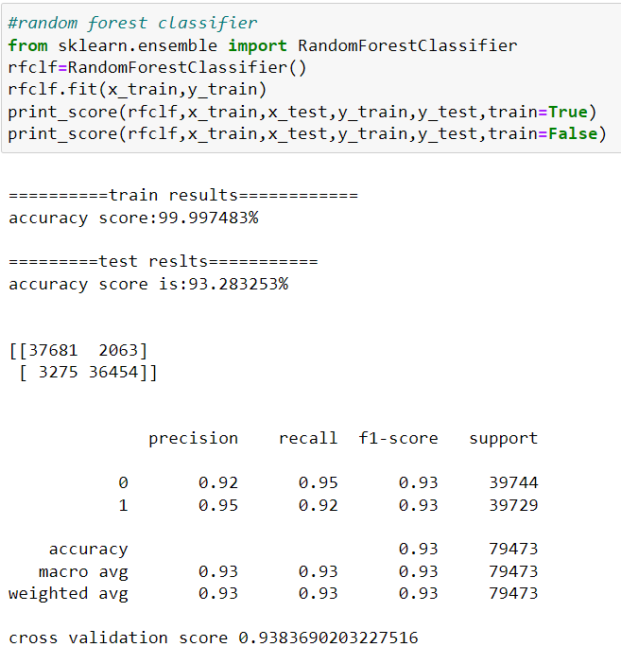
DECISION TREE CLASSIFIER RANDIOM FOREST CLASSIFIER

Slide 12
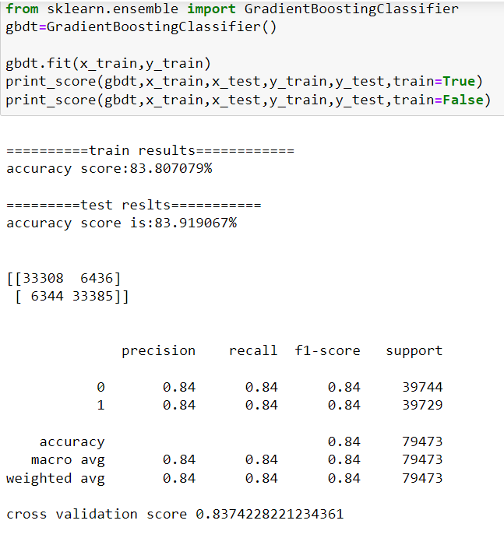
GRADIENT BOOSTING CLASSIFIER

Slide 13
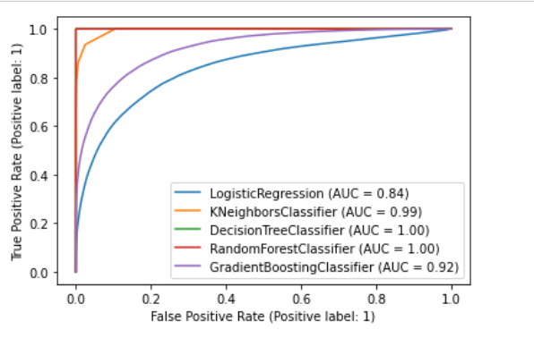
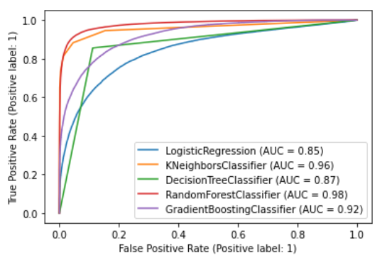
CHECKING WITH ROC AUC CURVES FOR TRIANING DATA FOR TESTING DATA
Observation:- the above plots shows random forest,gradient boosting clasifier and kneighborsclassifier are given best results but iam choosing kneighbors classifier as final model since our problem is related to bussiness scenerio so we consider false positive rate should be minimum or less so in the knn FP rate is less than all other so this is the best model for choosing as final

Slide 14
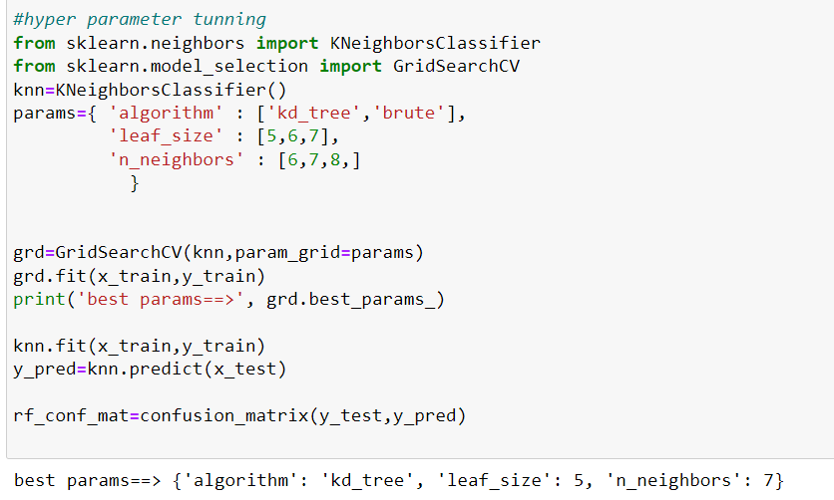
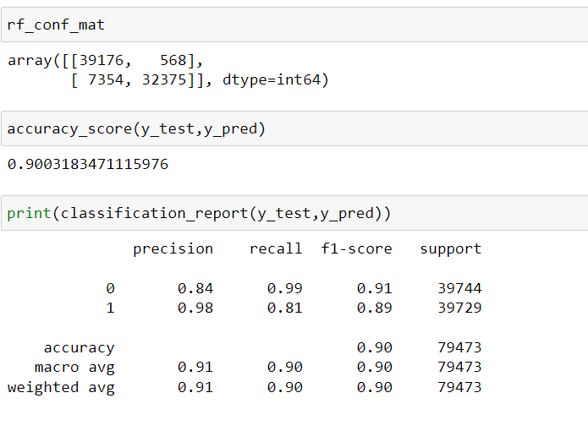
Hyper parameter tunning

Slide 15
Coclusion Our problem is related to business so we make sure false positive rate is as much as less so I can choose KNN is the final model But in the hyper parameter tunning the result is not improved, due to my system confegaratuion iam choosing less count in every parameter and in tbhe cross validation also iam given 10 only. But there is a chance to improve the results by increasing the values in the hyperparameter tunning and cross validations

